Slide 1


Slide 2

Speech recognition still does not match the fantasy of science fiction:
  demands of user's working memory
  background noise problematic
  variations in user speech performance impacts effectiveness
  most useful in specific applications, such as to benefit handicapped users

Slide 3

recognize individual words spoken by a specific person; can work with 90- to 98-percent reliability for 20 to 200 word vocabularies
Speaker-dependent training, in which the user repeats the full vocabulary once or twice
Speaker-independent systems are beginning to be reliable enough for certain commercial applications
been successful in enabling bedridden, paralyzed, or otherwise disabled people to broaden the horizons of their life

Slide 4
also useful in applications with at least one of the following conditions:
  speaker's hands are occupied
  mobility is required
  speaker's eyes are occupied
  harsh or cramped conditions preclude use of keyboard
voice-controlled editor versus keyboard editor
  lower task-completion rate
  lower error rate
use can disrupt problem solving

Slide 5

Not generally available:
  difficulty in recognizing boundaries between spoken words
  normal speech patterns blur boundaries
  many potentially useful applications if perfected

Slide 6

Voice mail users can
  receive messages
  replay messages
  reply to caller
  forward messages to other users, delete messages
  archive messages

Slide 7

Michaelis and Wiggins (1982) suggest that speech generation is "frequently preferable" under these circumstances:
The message is simple.
The message is short.
The message will not be referred to later.
The message deals with events in time.
The message requires an immediate response.
The visual channels of communication are overloaded.
The user must be free to move around.

Slide 8
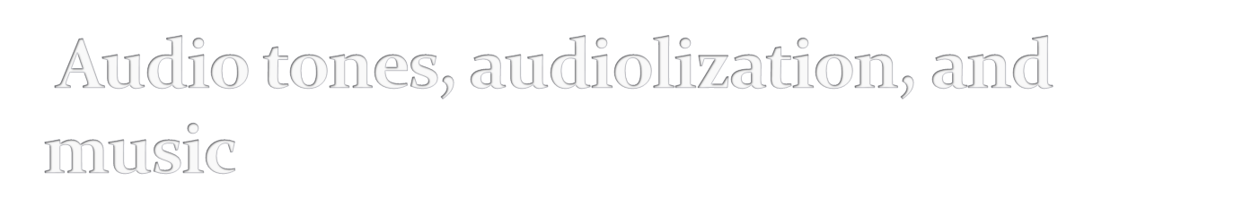
Sound feedback can be important
  to confirm actions
  offer warning
  for visually-impaired users
  music used to provide mood context, e.g. in games
  Can provide unique opportunities for user, e.g. with simulating various musical instruments

